Slide 1

Distributed Resilient Consensus
Nitin Vaidya
University of Illinois at Urbana-Champaign

Slide 2
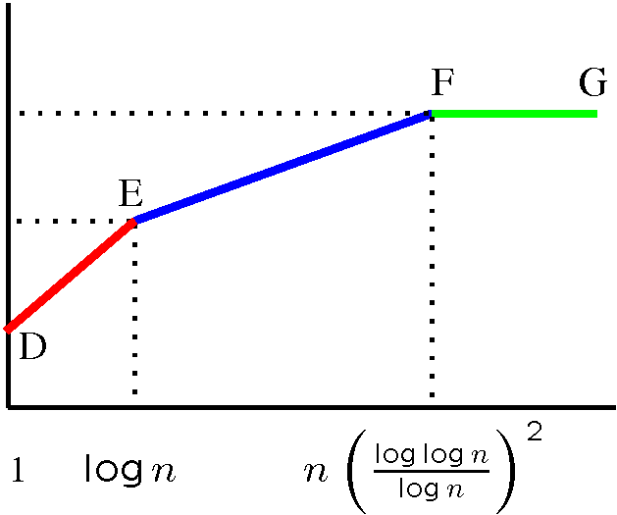
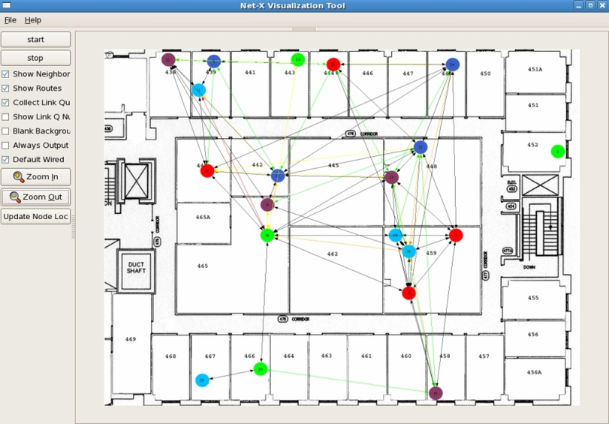
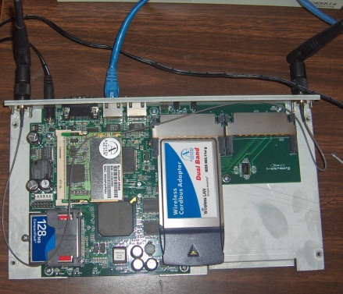
Net-X: Multi-Channel Mesh
Theory to Practice
D
Fixed
capacity
E
F
B
A
Switchable
C
channels
Capacity
bounds
Insights on
protocol design
Net-X
testbed
OS improvements
Software architecture
User
Applications
Multi-channel
protocol
IP Stack
ARP
Channel Abstraction Module
Interface
Device Driver
Interface
Device Driver
Linux box
CSL

Slide 3


Acknowledgments
Byzantine consensus
  Vartika Bhandari
  Guanfeng Liang
  Lewis Tseng
Consensus over lossy links
  Prof. Alejandro Dominguez-Garcia
  Prof. Chris Hadjicostis

Slide 4
Consensus … Dictionary Definition
General agreement

Slide 5

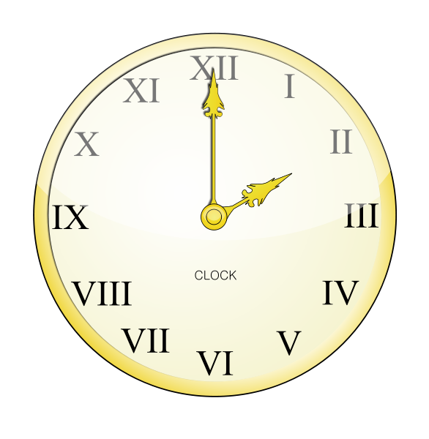

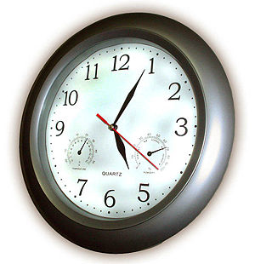
Many Faces of Consensus
What time is it?
Network of clocks …
agree on a common notion of time

Slide 6

Many Faces of Consensus
Commit or abort ?
Network of databases …
agree on a common action

Slide 7
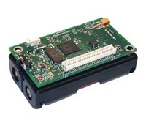
Many Faces of Consensus
What is the temperature?
Network of sensors …
agree on current temperature

Slide 8

Many Faces of Consensus
Should we trust ?
Web of trust …
agree whether is good or evil

Slide 9


Many Faces of Consensus
Which way?

Slide 10
Many Faces of Consensus
Which cuisine for dinner tonight?
Korean
Chinese
Thai

Slide 11
Consensus Requires Communication
Exchange preferences with each other
Korean
Chinese
Thai

Slide 12
Consensus Requires Communication
Exchange preferences with each other
Korean
CKT
Chinese
CKT
Thai
CKT

Slide 13
Consensus Requires Communication
Exchange preferences with each other
Choose “smallest” proposal
Korean
CKT ➔ C
Chinese
CKT ➔ C
Thai
CKT ➔ C

Slide 14
Complications
Most environments are not benign
Faults
Asynchrony

Slide 15
Complications
Most environments are not benign
Faults
Asynchrony

Slide 16
Crash Failure
fails without sending own preference to
Korean
CKT
Chinese
Thai
KT
Round 1

Slide 17
Crash Failure
One more round of exchange among fault-free nodes
Korean
CKT
CKT
Chinese
Thai
KT
CKT
Round 1
Round 2

Slide 18
Crash Failure
One more round of exchange among fault-free nodes
Korean
CKT
CKT ➔ C
Chinese
Thai
KT
CKT ➔ C
Round 1
Round 2

Slide 19
Crash Failures
Well-known result
… need f+1 rounds of communication
in the worst-case

Slide 20
Complications
Most environments are not benign
Faults
Asynchrony

Slide 21
Asynchrony
Message delays arbitrarily large
Difficult to distinguish between a slow message, and message that is not sent (due to faulty sender)

Slide 22
Asynchrony + Crash Failure
Messages from slow to reach others.
Others wait a while, and give up … suspecting faulty.
Korean
KT
Chinese
CKT
Thai
KT
Round 1

Slide 23
Asynchrony + Crash Failure
Messages from slow to reach others
Korean
KT
KT ➔ K
Chinese
CKT
CKT ➔ C
Thai
KT
KT ➔ K
Round 1
Round 2

Slide 24
Asynchrony + Crash Failures
Another well-known (disappointing) result
… consensus impossible with asynchrony + failure

Slide 25
Asynchrony + Failures
Impossibility result applies to exact consensus,
approximate consensus still possible
even if failures are Byzantine

Slide 26
Byzantine Failure
Byzantine faulty
Korean
Indian
Chinese
Chinese
Thai
Round 1

Slide 27
Byzantine Failures
Yet another well-known result
… 3f+1 nodes necessary to achieve consensus in presence of Byzantine faults

Slide 28
Related Work
30+ years of research
Distributed computing
Decentralized control
Social science (opinion dynamics, network cascades)

Slide 29
Pre-history
1980: Byzantine exact consensus, 3f+1 nodes
1983: Impossibility of exact consensus
with asynchrony & failure
Tsitsiklis 1984:
Decentralized control
[Jadbabaei 2003]
(Approximate)
1986: Approximate consensus
with asynchrony & failure

Slide 30
Pre-history
Hajnal 1958 (weak ergodicity of
non-homogeneous
Markov chains)
1980: Byzantine exact consensus, 3f+1 nodes
1983: Impossibility of exact consensus
with asynchrony & failure
Tsitsiklis 1984:
Decentralized control
[Jadbabaei 2003]
(Approximate)
1986: Approximate consensus
with asynchrony & failure

Slide 31
Consensus
30+ years of research
Anything new under the sun ?

Slide 32
Consensus
30+ years of research
Anything new under the sun ?
… more refined network models

Slide 33
Our Contributions
Average consensus over lossy links
Byzantine consensus
    Directed graphs
    Capacitated links
    Vector inputs

Slide 34
Average Consensus
Each node has an input
Nodes agree (approximately) on average of inputs
No faulty nodes

Slide 35
Distributed Iterative Solution … Local Computation
Initial state a, b, c = input
b
c
a

Slide 36
Distributed Iterative Solution
State update (iteration)
b
b = 3b/4+ c/4
c
c = a/4+b/4+c/2
a = 3a/4+ c/4
a

Slide 37
:=
= M
M
b
b = 3b/4+ c/4
c
c = a/4+b/4+c/2
a = 3a/4+ c/4
a

Slide 38
after 2 iterations
after 1 iteration
:= M M
= M²
b
b = 3b/4+ c/4
c
c = a/4+b/4+c/2
a = 3a/4+ c/4
a

Slide 39
after k iterations
:= M^{k}
b
b = 3b/4+ c/4
c
c = a/4+b/4+c/2
a = 3a/4+ c/4
a

Slide 40
Well-Known Results
Reliable links & nodes:
Consensus achievable iff
at least one node can reach all other nodes
Average consensus achievable iff
strongly connected graph
with suitably chosen transition matrix M

Slide 41
Well-Known Results
Reliable links & nodes:
Consensus achievable iff
at least one node can reach all other nodes
Average consensus achievable iff
strongly connected graph
with suitably chosen transition matrix M
Row
stochastic M

Slide 42
Well-Known Results
Reliable links & nodes:
Consensus achievable iff
at least one node can reach all other nodes
Average consensus achievable iff
strongly connected graph
with suitably chosen transition matrix M
Row
stochastic M
Doubly stochastic M

Slide 43
:= M^{k}
➔
Doubly stochastic M
b
b = 3b/4+ c/4
c
c = a/4+b/4+c/2
a = 3a/4+ c/4
a

Slide 44
Asynchrony
Asynchrony results in time-varying transition matrices
Results hold under mild conditions [Hajnal58]

Slide 45
An Implementation:
Mass Transfer + Accumulation
Each node “transfers mass” to neighbors via messages
Next state = Total received mass
b
b = 3b/4+ c/4
c/4
c
c/2
c/4
c = a/4+b/4+c/2
a = 3a/4+ c/4
a

Slide 46
An Implementation:
Mass Transfer + Accumulation
Each node “transfers mass” to neighbors via messages
Next state = Total received mass
b
3b/4
b = 3b/4+ c/4
c/4
c
c/2
b/4
c/4
c = a/4+b/4+c/2
a/4
3a/4
a = 3a/4+ c/4
a

Slide 47
Conservation of Mass
a+b+c constant after each iteration
b
3b/4
b = 3b/4+ c/4
c/4
c
c/2
b/4
c/4
c = a/4+b/4+c/2
a/4
3a/4
a = 3a/4+ c/4
a

Slide 48
Wireless Transmissions Unreliable
b
X
b = 3b/4+ c/4
c
X
c = a/4+b/4+c/2
c/4
a = 3a/4+ c/4
a

Slide 49
Impact of Unreliability
=
b
X
b = 3b/4+ c/4
X
c
c = a/4+b/4+c/2
c/4
a = 3a/4+ c/4
a

Slide 50
Conservation of Mass
X
=
b
X
b = 3b/4+ c/4
X
c
c = a/4+b/4+c/2
c/4
a = 3a/4+ c/4
a

Slide 51
Average consensus over lossy links ?

Slide 52
Existing Solution
When mass not transferred to neighbor,
keep it to yourself

Slide 53
=
b
X
b = 3b/4+ c/4
X
c
c = a/4+b/4+c/2+c/4
c/4
a = 3a/4+ c/4
c/4
a

Slide 54
Existing Solutions … Link Model
Common knowledge on whether a message is delivered
S
R

Slide 55
Existing Solutions … Link Model
Common knowledge on whether a message is delivered
S knows
R knows that S knows
S knows that R knows that S knows
R knows that S knows that R knows that …
S
R

Slide 56
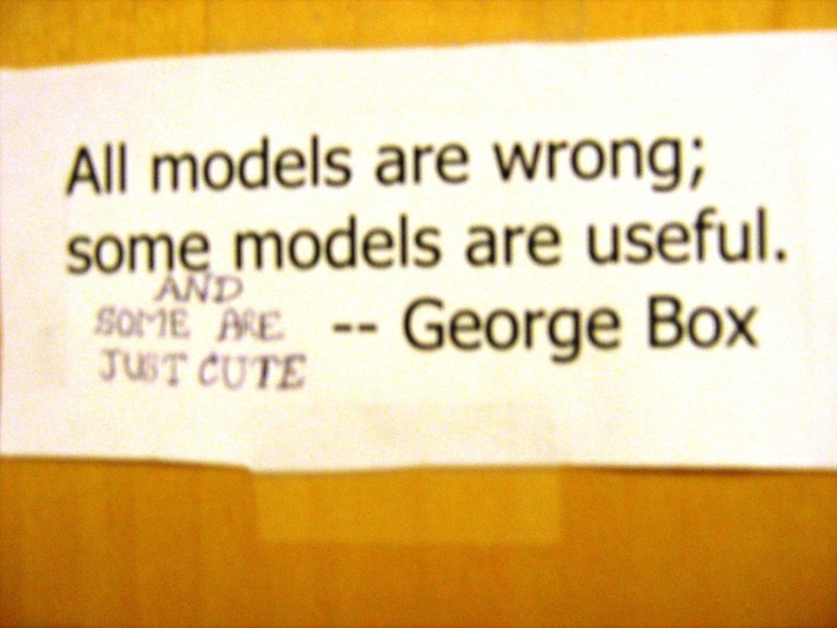

Slide 57
Reality in Wireless Networks
Common knowledge on whether a message is delivered
Two scenarios:
A’s message to B lost … B does not send Ack
A’s message received by B … Ack lost
X

Slide 58
Reality in Wireless Networks
Common knowledge on whether a message is delivered
➔ Need solutions that tolerate lack of common knowledge
X

Slide 59
Our Solution
Average consensus without common knowledge
… using additional per-neighbor state

Slide 60
Solution Sketch
S
C
R
S = mass C wanted to transfer to node A
in total so far
R = mass A has received from
node C
in total so far
A
S
R

Slide 61
Solution Sketch
C
R
S
Node C transmits quantity S
…. message may be lost
When it is received,
node A accumulates (S-R)
A
S
S-R
R

Slide 62
What Does That Do ?

Slide 63
What Does That Do ?
Implements virtual buffers
b
d
e
c
f
g
a

Slide 64
Dynamic Topology
When C→B transmission unreliable,
mass transferred to buffer (d)
d = d + c/4
b
d
c
a

Slide 65
Dynamic Topology
When C→B transmission unreliable,
mass transferred to buffer (d)
d = d + c/4
b
d
No loss
of mass
even with
message loss
c
a

Slide 66
Dynamic Topology
When C→B transmission reliable,
mass transferred to b
b = 3b/4 + c/4 + d
b
d
No loss
of mass
even with
message loss
c
a

Slide 67
Time-Varying Column Stochastic Matrix
Mass is conserved
Time-varying network
➔ Matrix varies over iterations
Matrix M_{i} for i-th iteration

Slide 68
State Transitions
V = state vector =
V[0] = initial state vector
V[t] = iteration t

Slide 69
State Transitions
V[1] = M₁ V[0]
V[2] = M₂ V[1] = M₂ M₁ V[0]
…
V[t] = M_{k} M_{k-1} … M₂ M₁ V[0]

Slide 70
State Transitions
V[t] = M_{k} M_{k-1} … M₂ M₁ V[0]
Matrix product converges to
column stochastic matrix with identical columns
…

Slide 71
State Transition
After k iterations
…
k+1
M_{k+1}
…
z
z
z
=
…

Slide 72
State Transition
After k iterations
…
k+1
M_{k+1}
…
z
w
z
w
z
w
z * sum
=
…
w * sum

Slide 73
State Transitions
After k iterations, state of first node has the form
z(k) * sum of inputs
where z(k) changes each iteration (k)
Does not converge to average

Slide 74
Solution
Run two iterations in parallel
  First : original inputs
  Second : input = 1

Slide 75
Solution
Run two iterations in parallel
  First : original inputs
  Second : input = 1
After k iterations …
first algorithm: z(k) * sum of inputs
second algorithm: z(k) * number of nodes

Slide 76
Solution
Run two iterations in parallel
  First : original inputs
  Second : input = 1
After k iterations …
first algorithm: z(k) * sum of inputs
second algorithm: z(k) * number of nodes
ratio = average

Slide 77
numerator
denominator
time
time
ratio
time

Slide 79
Byzantine Consensus

Slide 80
b
b = 3b/4+ c/4
c = a/4+b/4+c/2
a = 3a/4+ c/4
a

Slide 81
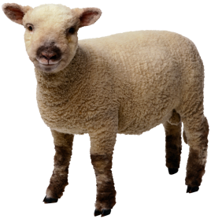
b
b = 3b/4+ c/4
c = a/4+b/4+c/2
Byzantine
node
a = 3a/4+ c/4
a

Slide 82
b
b = 3b/4+ c/4
c = a/4+b/4+c/2
c = 2
Byzantine
node
c =1
a = 3a/4+ c/4
a
No consensus !

Slide 83
Prior Results
Necessary and sufficient conditions on undirected communication graph to be able to achieve Byzantine consensus
  Synchronous systems
  Asynchronous systems
3f+1 nodes
2f+1 connectivity

Slide 84
Our Results
Conditions on directed graphs to achieve Byzantine consensus
Motivated by wireless networks

Slide 85
Link Capacity Constraints
S
10
1
10
1
3
10
2
10
10
10
10
10

Slide 86
Byzantine Consensus … Lower Bound
Ω(n²) messages in worst case

Slide 87
Link Capacity Constraints
How to quantify the impact of capacity constraints ?

Slide 88
Throughput
Borrow notion of throughput from networking
b(t) = number of bits agreed upon in [0,t]

Slide 89
Problem Definition
What is the achievable throughput of consensus over a capacitated network ?
Results so far
… optimal algorithm for 4 nodes
… within factor of 3 in general

Slide 90
Summary
Many applications of consensus
Large body of work
Still many interesting problems open

